Slide 1

Prepared by Logical Operators
for COSC 3F00
March 20th, 2014

Slide 2
Review
Using Agile principles
Split project into time-boxed iterations
Created and prioritized the list of features
Pulled highest priority features into the current iteration

Slide 3
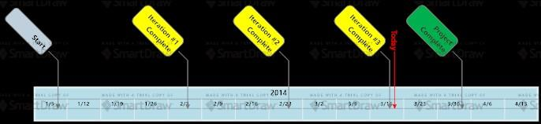
Project Timeline

Slide 4
Iteration #3 Goals
Pulled the next set of features from the backlog
Artificial intelligence integration
Initiate some architecture and database work to support online play
Help section
Refactoring to reduce technical debt
Improve project progress

Slide 5
Planning
All tasks are tracked in GitHub
Split the 3 week iteration into 1 week sprints stressing completion of functionality each week
Analysis, design, construction and testing spawned many subtasks eventually leading to a total of 50 project tasks

Slide 6
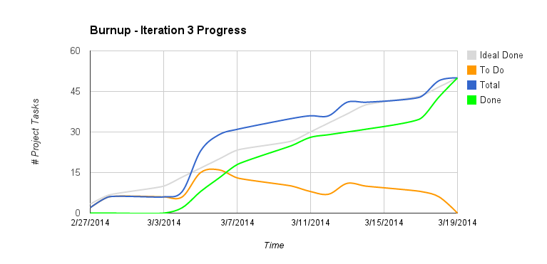

Slide 7
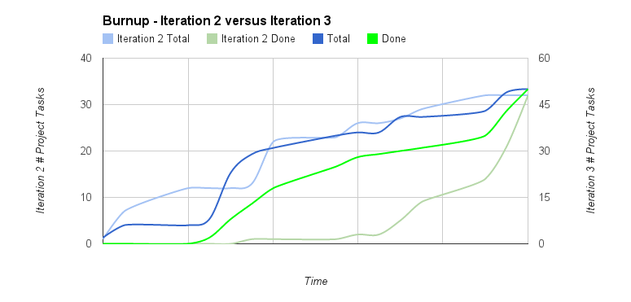

Slide 8
Observations
Iteration 3 was same duration as iteration 2
Observable improvement progress consistency which made for a smoother iteration
Goal for next iteration will be to continue this trend

Slide 9
Continuing Other Iteration Activities
GitHub used to house all artifacts, source code and automated tests
Analysis and design artifacts followed conventions from previous iterations
Construction and testing was done using AndroidStudio
travis-ci.org used for continous integration

Slide 10
Next Iteration Goals
Finalize network capabilities for online features and game play over the internet

Slide 11
Ready For A Demo?
Agile Principle #1:
“Our highest priority is to satisfy the customer through early and continuous delivery of valuable software.”
Source: agilemanifesto.org/principles.html

Slide 12
Demonstration

Slide 13
Feedback?
Q&A

Slide 14
Thank you

